Slide 1
Distinctive Image Features from Scale-Invariant Keypoints
2022. 07. 28
Jungyun Kim

Slide 2
object or scene
recognition
motion
tracking
Computer
Vision
solving for 3D structure
from multiple images
object or scene
recognition
stereo correspondence
image
matching

Slide 3
Generate the set of image features
Features
Scale-space
Extrema
detection
Keypoint
localization
Orientation
assignment
Keypoint
descriptor

Slide 4
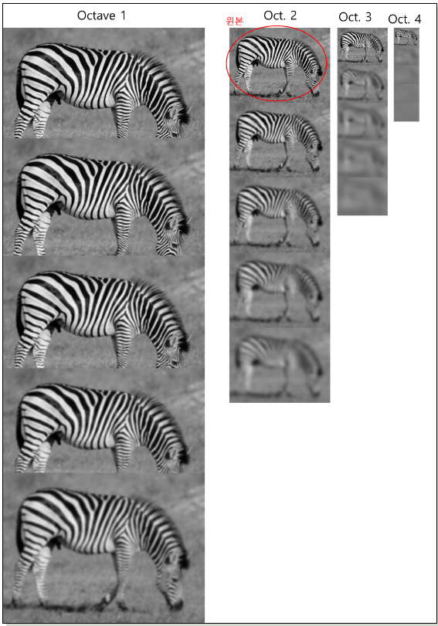
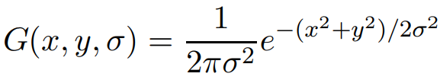

Detection of Scale-Space Extrema
Scale Space
blurred
image
Variable-scale Gaussian
Input
Image
Difference-of-Gaussian

Slide 5
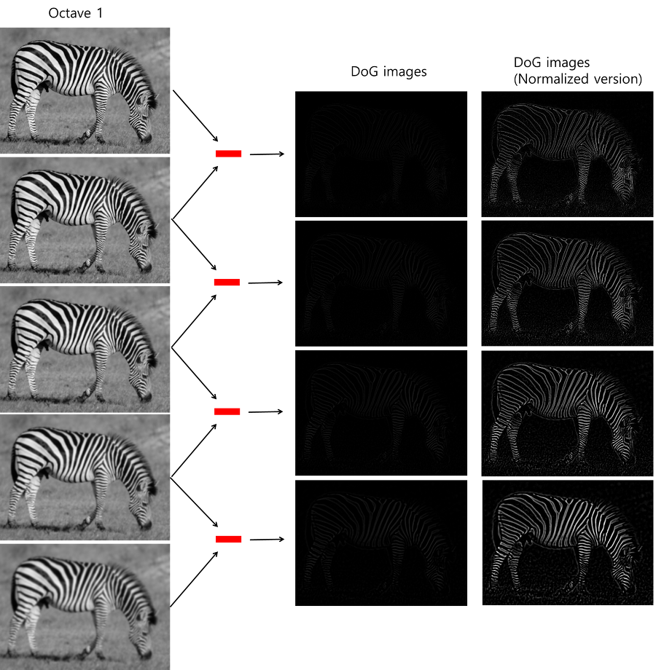
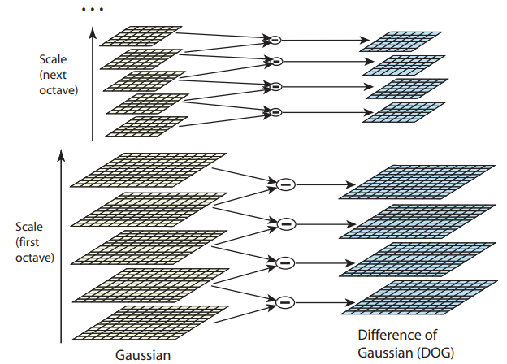
Detection of Scale-Space Extrema

Slide 6
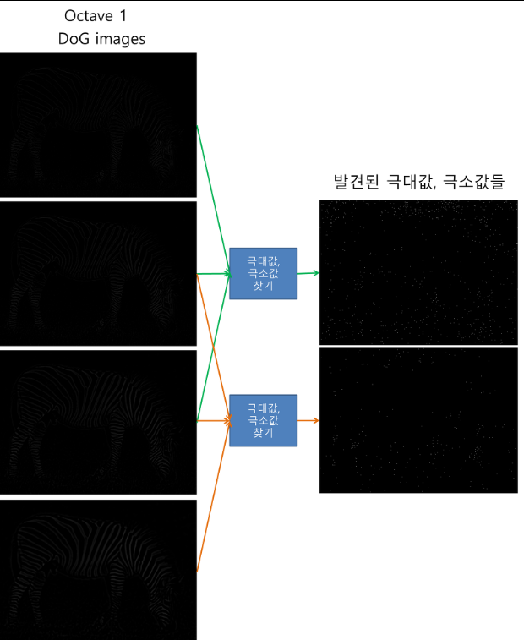
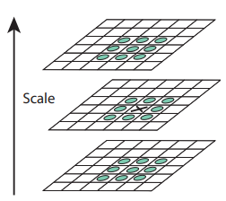
Keypoint Localization

Slide 7
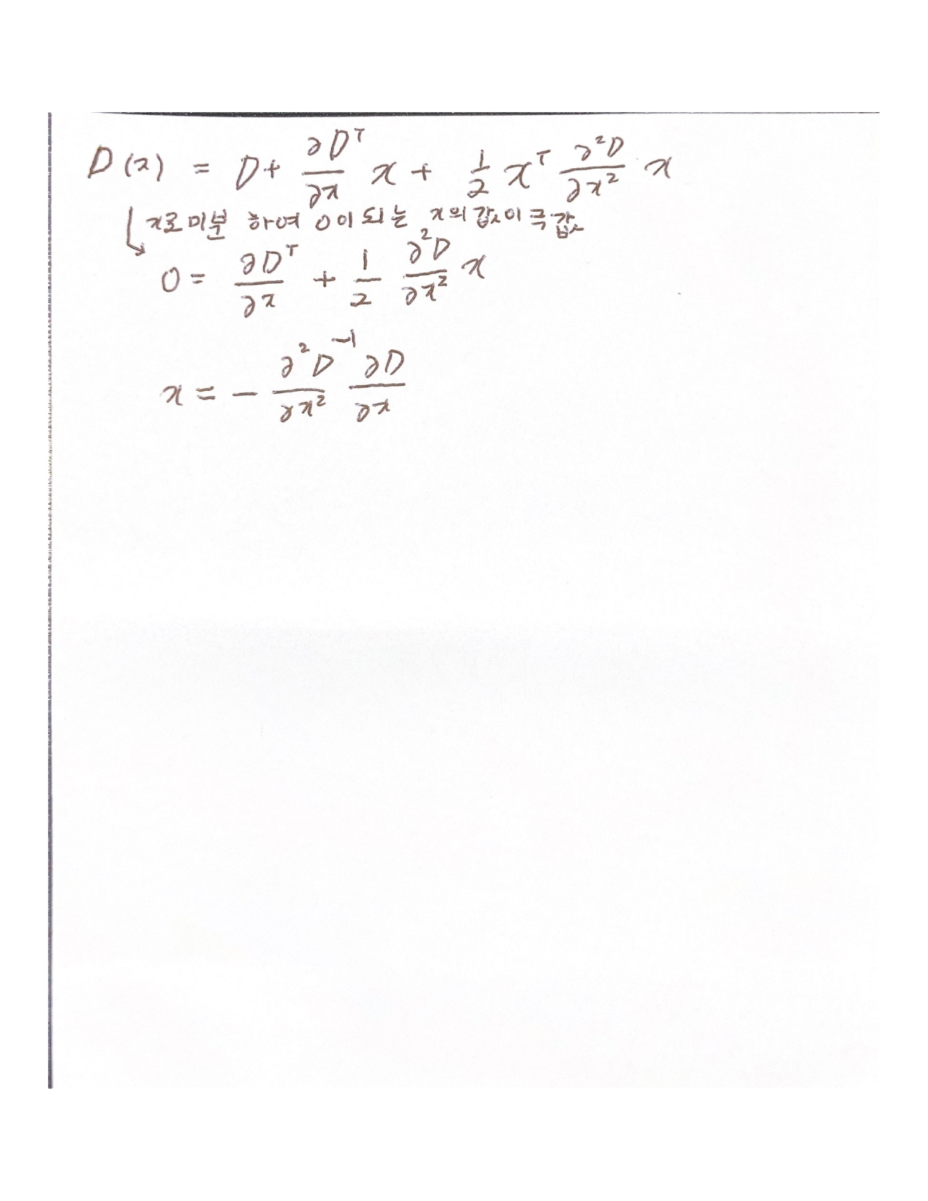

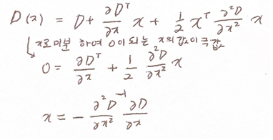


Keypoint Localization
Brown and Low. 2002
Notes:
더 정확한 extrema를 얻기 위해 테일러 전개를 통해 그점의 contrast를 구해서 key를 걸러냅니다.

Slide 8



Harris Corner Detector

Slide 9
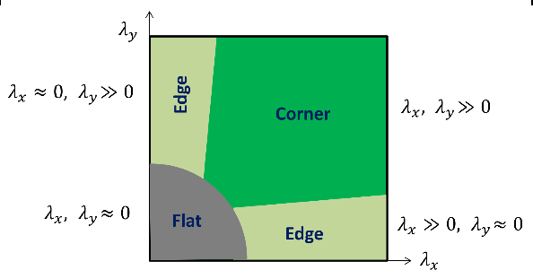


To check that the ratio of principal curvatures is below some threshold, r

Slide 10
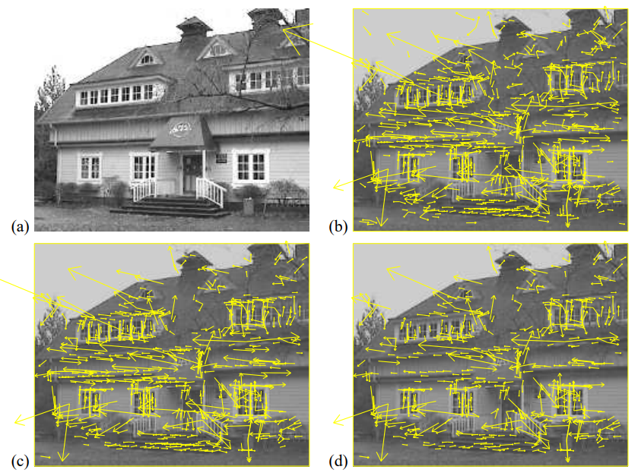
Keypoint Localization
233x189 original image
Initial 832 keypoints locations (maxima/minima)
After applying a threshold 729 keypoints
After applying a threshold on minimum contrast 536 keypoints

Slide 11
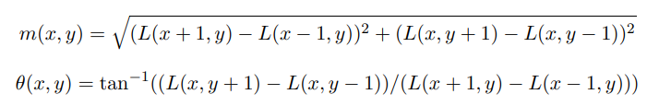
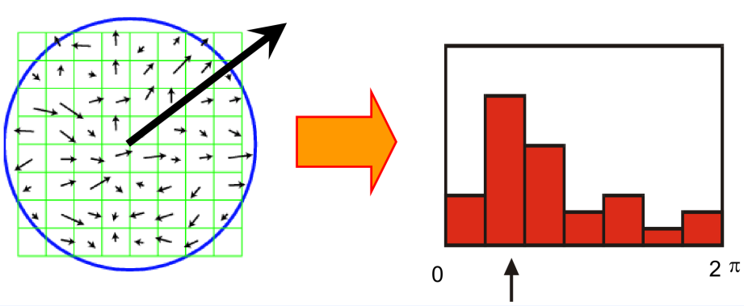
Orientation Assignment
상당히 많은 후보 keypoint들이 제거되고 유의미한 keypoint만 남았습니다.
Compute gradient magnitude and orientation around keypoints
Any peak within 80% of the highest peak is used to create another keypoint with that orientation
(Generating multiple candidates)
Notes:
히스토그램에서 가장 높은 피크가 감지된 다음 가장 높은 피크의 80% 내에 있는 다른 로컬 피크를 사용하여 해당 방향의 키포인트도 생성합니다.
따라서 비슷한 크기의 여러 봉우리가 있는 위치의 경우 동일한 위치와 scale이지만 방향이 다른 여러 키포인트가 생성됩니다.

Slide 12
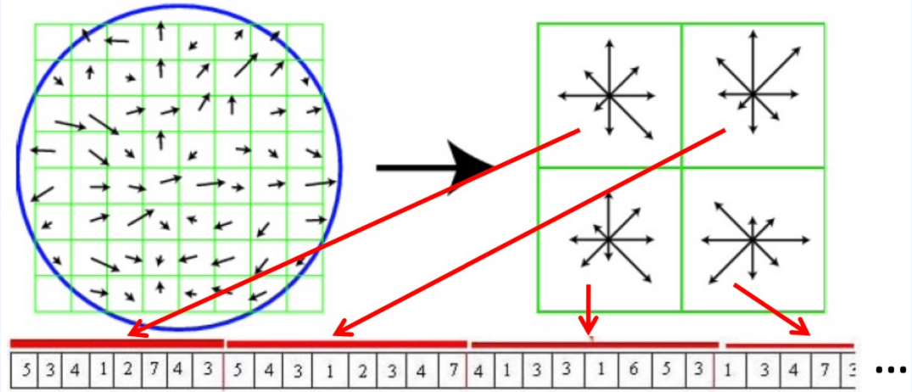
Keypoint Descriptor
Build a histogram
128dimension
Angle histogram binning starts from the most dominant orentation
Normalized to unist length

Slide 13
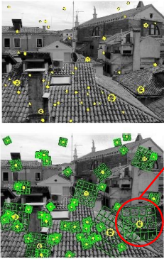
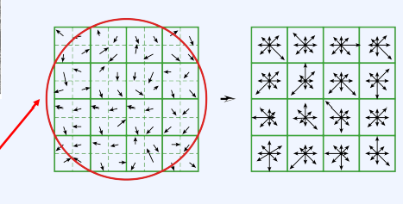
Keypoint Descriptor

